Slide 1
Database Management Systems New and Old Book Purchase System(Book Wala)
By
2110030031- Sumeet Sharma
2110030190- K.Sai Vardhan Reddy
2110030252- Mohammed Afeef Sayeed
2110030109- D. Harshavardhan Reddy
Under the guidance of
P. Sree Lakshmi

Slide 2
Problem statement and domain
This projects aims to develop an Application New and Old Book Purchase System for Customers.
The main objective of the Online Book Store is to manage the details of the Books , Customer , Payments. It manages all the information about Books, Bills.

Slide 3
Existing solutions/ Naïve solutions
https://link.springer.com/article/10.1023/A:1026076314992
https://timesofindia.indiatimes.com/life-style/books/features/heres-why-second-hand-books-are-losing-its-market/articleshow/53823611.cms\
(Pandemic and New Books available online)
https://core.ac.uk/download/pdf/301369506.pdf
(online bookstore effecting the traditional bookstores)

Slide 4
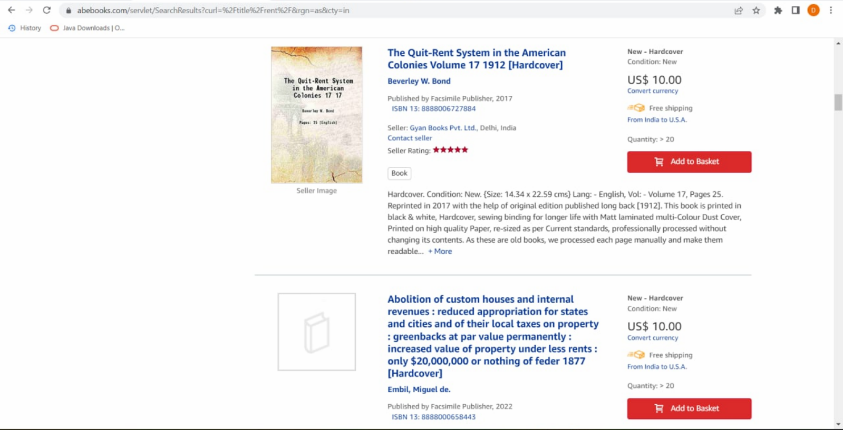
No Rent , Pay On Delivery options.

Slide 5
Proposed Algorithm Design Technique
What is the technique
1.Dynamic Programming
2.Exhaustive Search
How is it suitable for your application
1.Dynamic Programming is helpful to efficiently solve problems.
2. Exhaustive search is a brute force approach to solving a problem that involves searching for an element with a special property, usually among combinatorial objects such permutations, combinations, or subsets of a set.

Slide 6
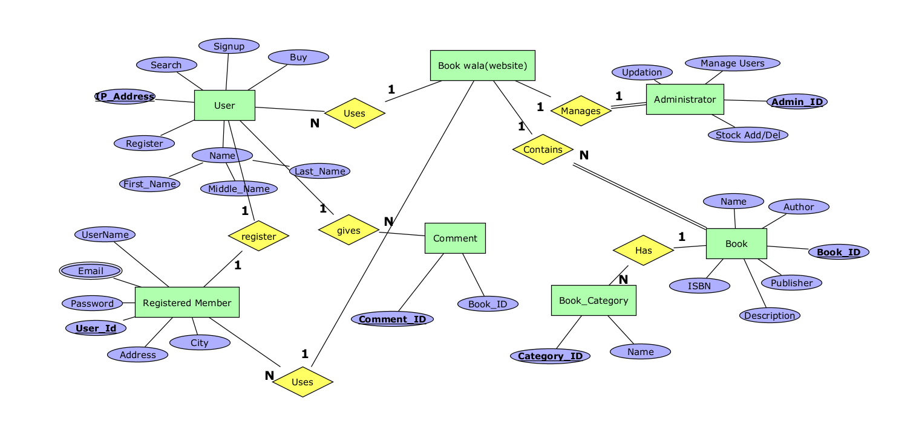
What do you know about the solution of it using proposed design method
ER Diagram :

Slide 7
Data Structures needed
Tools:
MYSQL
TerraER

Slide 8

Github setup
https://github.com/Afeef16556/New-and-Old-book-Purchase-System

Slide 9
Division of work among the group members
2110030031 - ER Diagram,Articles
2110030190 - Database creation , Article
2110030109 - PPT and Documentation
2110030252 - Data Base Creation , Documentation.

